Slide 1
“Wheat” does it all mean?
Tim, Hamza, Thierry, Oto
Notes:
Thierry

Slide 2
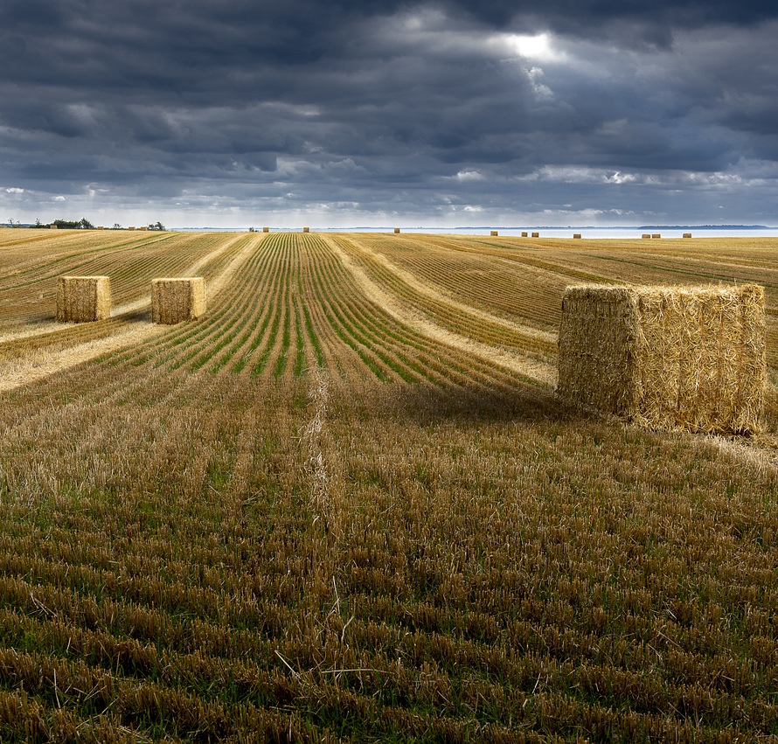
Outline
Background: 2 minutes
Study Design: 2 minutes
Algorithm results
RF: 2 minute
SVM: 1 minute
XGBoost: 1 minute
Takeaways: 5 minutes
Questions
Notes:
Thierry
https://pixabay.com/photos/wheat-wheatfields-countryside-field-4923135/

Slide 3
Background
Detect and classify winter wheat Triticum aestivum L. crop type mapping.
Effort will be based in the US employing the USDA’s National Agricultural Statistics Service (NASS) crop layer.
Annual crop label will be utilized to predict a preceding year leveraging a set of ML and DL approaches.
Set of models will be cross evaluated to compare the relative performance.
Final products will be:
Set of tuned and trained models
Intercomparison of modeling techniques and packages
Code library
Notes:
Thierry

Slide 4
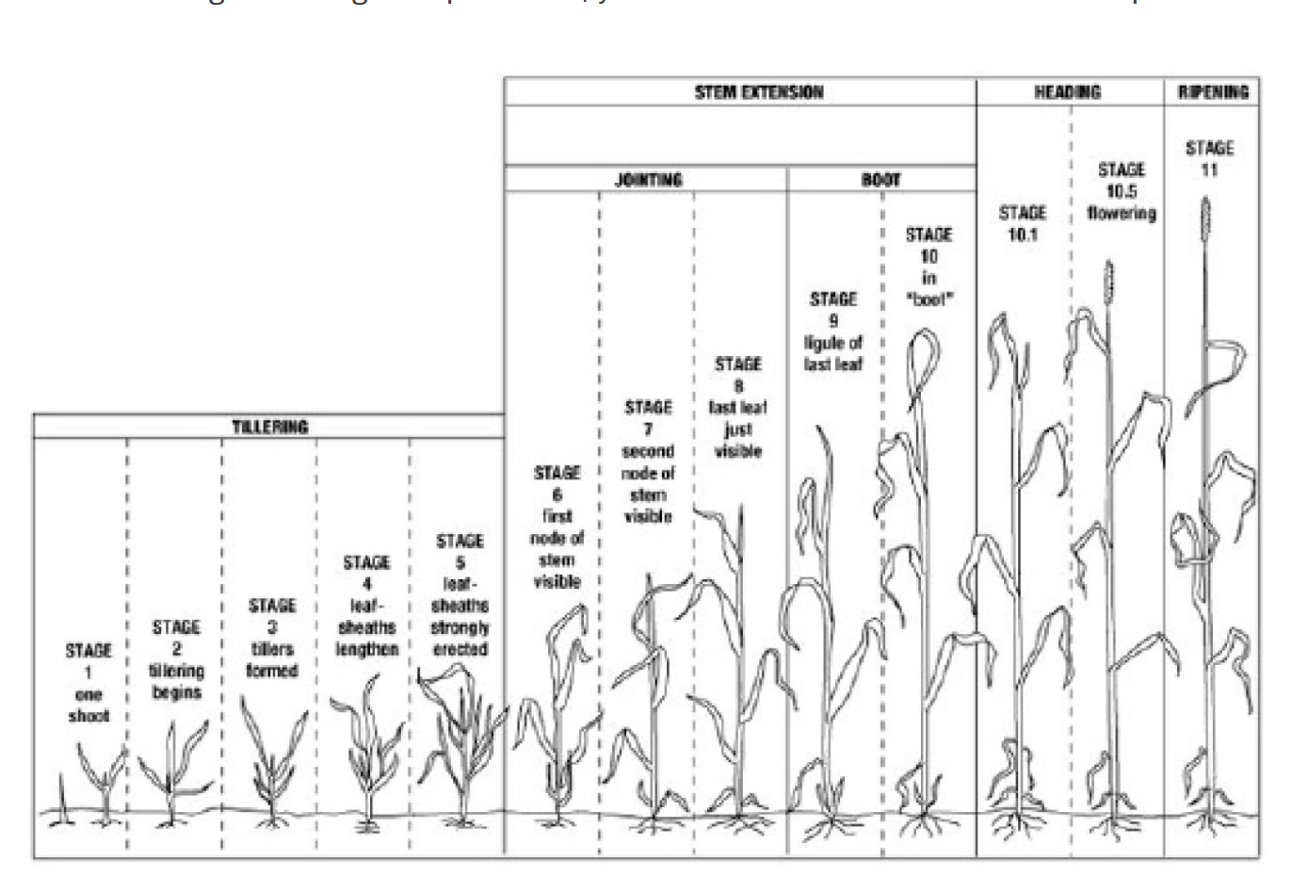
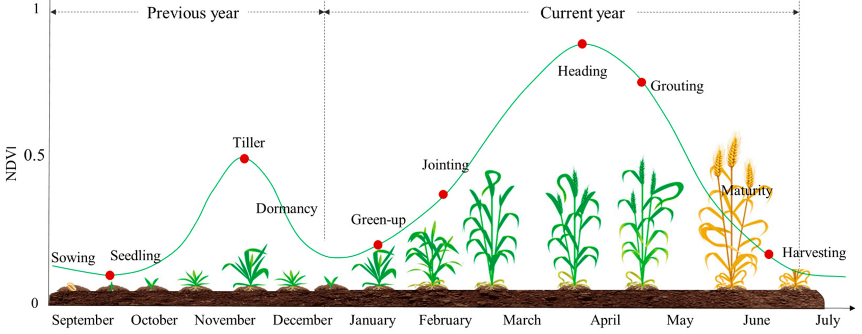
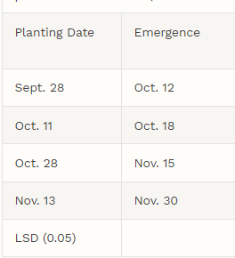
Relevant cultivation and phenological information
EO phenology mapping
Winter wheat, in general, displays a unique bimodal NDVI trend related to the dormancy period occurring during the winter (Heuer et al.1978).
This is a key factor in distinguishing, detecting, and classifying winter wheat crop type extent for 2023.
(Wang et al. 2022)
Notes:
Thierry
https://nebraskawheat.gov/for-growers/wheat-production-handbook/wheat-growth-stages/
Wang, S., Rao, Y., Chen, J., Liu, L. and Wang, W., 2021. Adopting “difference-in-differences” method to monitor crop response to agrometeorological hazards with satellite data: a case study of dry-hot wind. Remote Sensing, 13(3), p.482.
Heuer, G.R., Heermann, D.F., McKee, T.B. and Benci, J.F., 1978. Predicting winter wheat phenology using temperature and photoperiod (Master's thesis, Colorado State University).

Slide 5
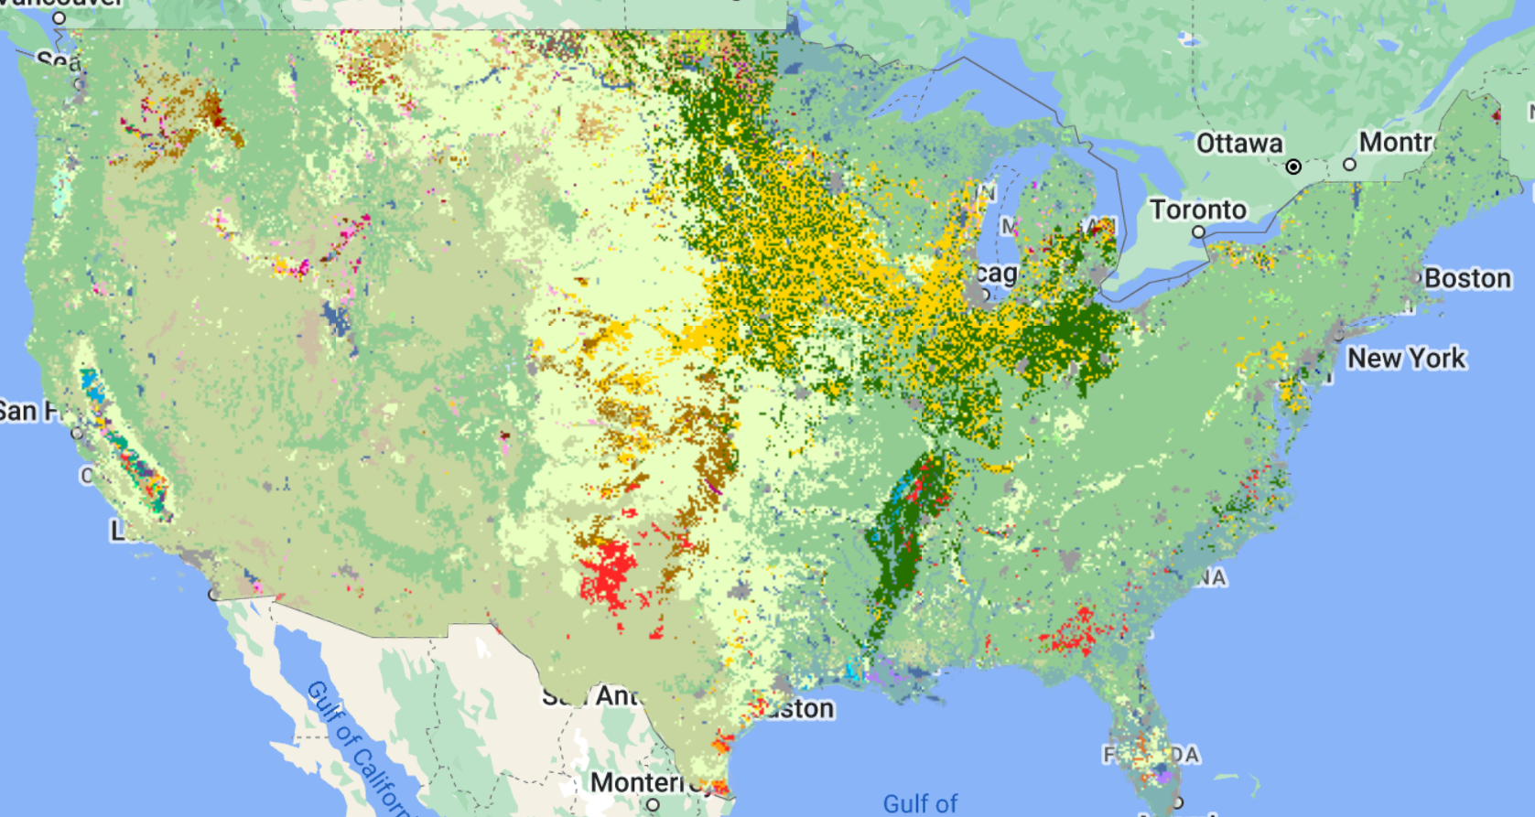
How
Use the NASS crop layer as a training label source (2022) | Background: 254 crop class for the CONUS | selected 1 of 9 wheat classes
Classify 2022 imagery across alg.
Cross compare algorithms
RF X2
SVM
XGBOOST
Evaluation metrics
Available NASA Wheat labels
Class | Crop type
22 | Durum Wheat
23 | Spring Wheat
24 | Winter Wheat
225 | Dbl Crop WinWht/Corn
229 | Dbl Crop Lettuce/Durum Wht
230 | Dbl Crop Durum Wht/Sorghum
234 | Dbl Crop Durum Wht/Sorghum
236 | Dbl Crop WinWht/Sorghum
238 | Dbl Crop WinWht/Cotton
NASS, U., 2022 USDA national agricultural statistics service cropland data layer. USDA-NASS, Washington, DC.
Hui Li, M.D.; Liping Di; Chen Zhang; Li Lin; Liying Guo; Eugene G. Yu; Zhengwei Yang, “Automated in-season crop-type data layer mapping without ground truth for the Conterminous United States based on multisource satellite imagery”, IEEE Transactions on Geoscience and Remote Sensing. Volume: 62, Page(s): 1-14, February 2024. https://doi.org/10.1109/TGRS.2024.3361895.
Notes:
Hamza

Slide 6
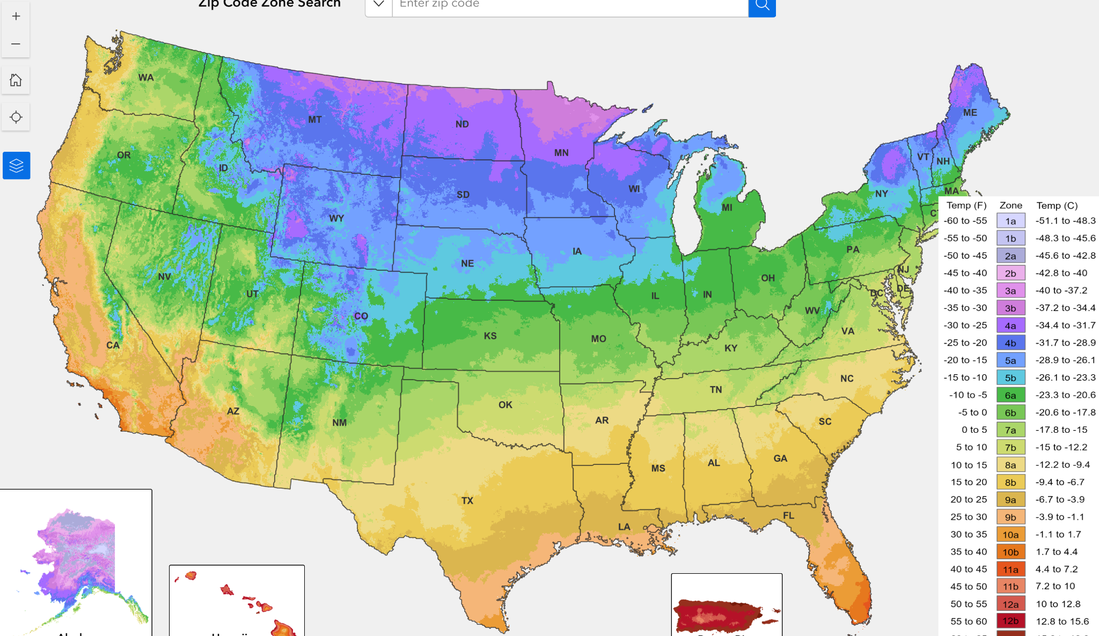
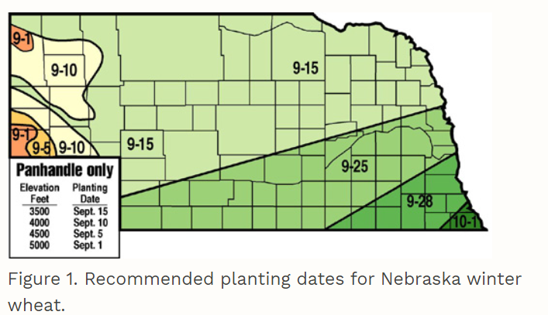
Data
Hardiness map of the US
Training/ Testing/ Validation:
Point labels of NASS crop layer
Winter Wheat
1000m spatial partition per data partition
Temporal
9/1/22- 6/31/23
Expected NDVI peaks Nov and April
Earth Observations
Harmonized Landsat Sentinel-2
NDVI
NDMI
EVI
SAVI
Landsat
NDVI
NMDI
EVI
SAVI
Tasseled cap
S-2
NDVI
NDMI
EVI
SAVI
ROI
DEM
Slope
Elevation
S-1
Ascending
Descending
VV
VH
Ratio
(CROPWATCH - University of Nebraska - Lincoln)
Notes:
Hamza
https://nebraskawheat.gov/for-growers/wheat-production-handbook/wheat-growth-stages/
https://cropwatch.unl.edu/winter-wheat-seeding-date-can-have-major-effect-yields#:~:text=The%20recommended%20seeding%20dates%20for,of%20research%20and%20farmer%20experience.

Slide 7
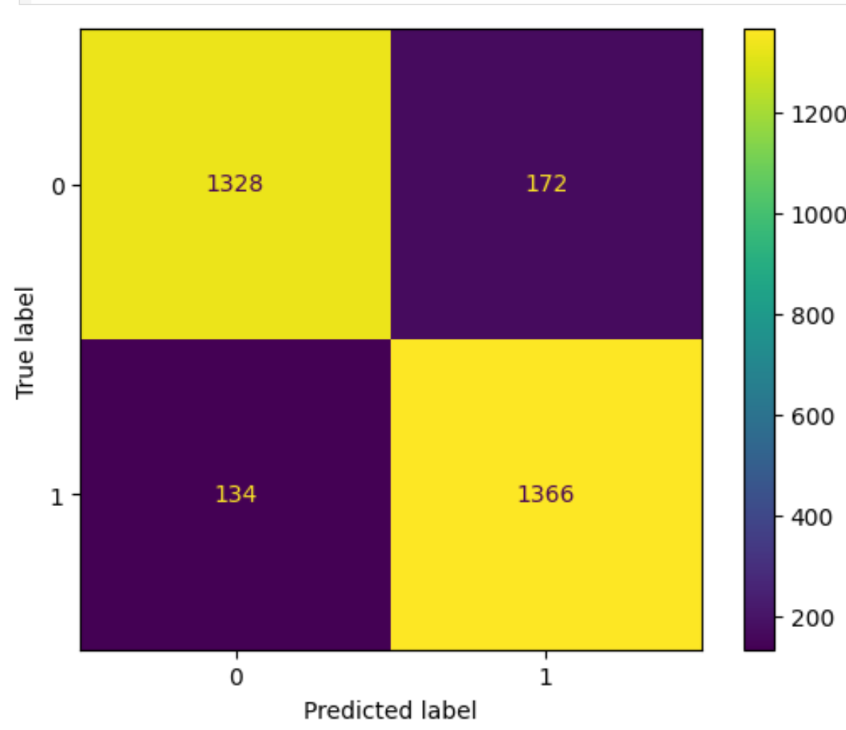
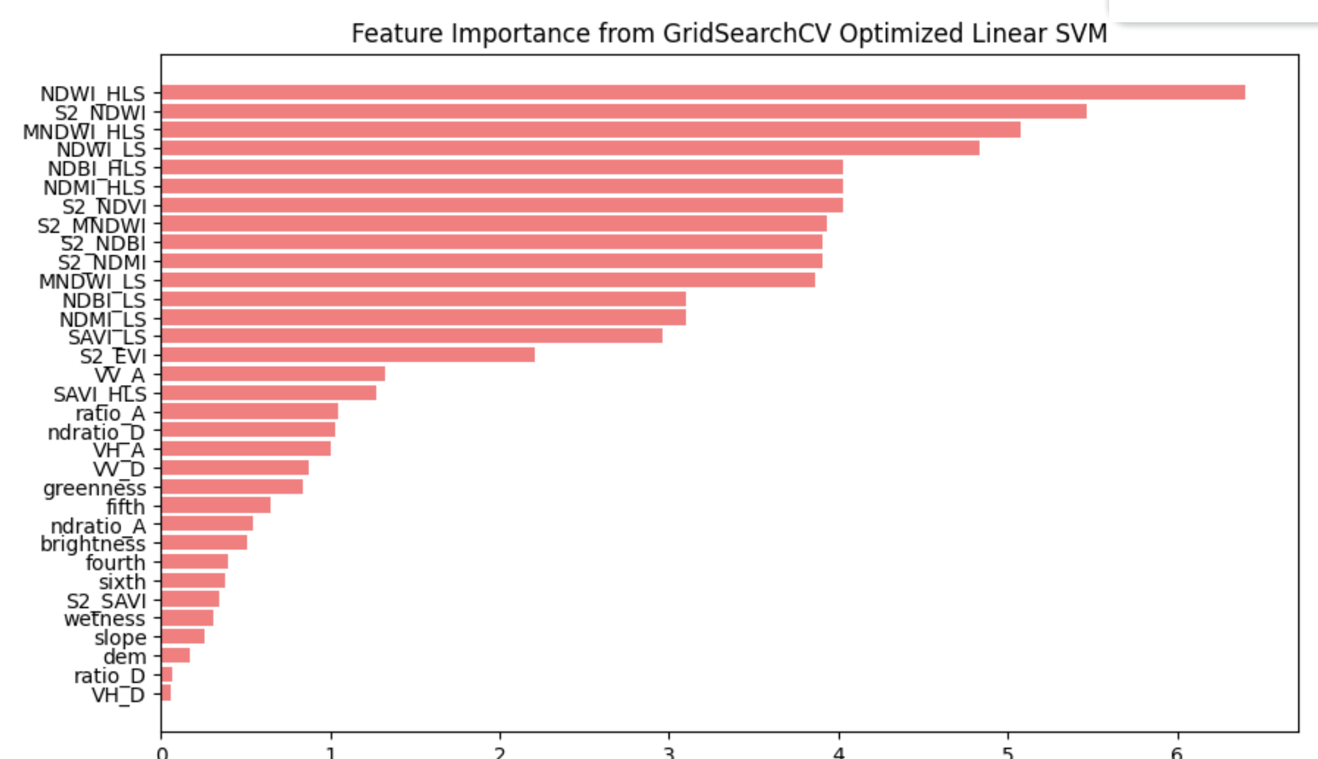
Preliminary testing SVM
Different data set Median composite of 9 months
And separate training points:
Preliminary Model Parameters Tested:
param_grid = {'kernel' : ['linear', 'rbf', 'sigmoid'],
'C' : [0.1, 1, 10, 100],
'degree' : [3],
'coef0' : [0.01,10],
'gamma' : [0.1, 0.01, 0.001]}
Going forward we were interested in exploring phenological signal across the growing season
Evaluation metrics | Testing
Accuracy | 0.898
Precision | 0.888
F1-Score | 0.899
Notes:
Tim

Slide 8
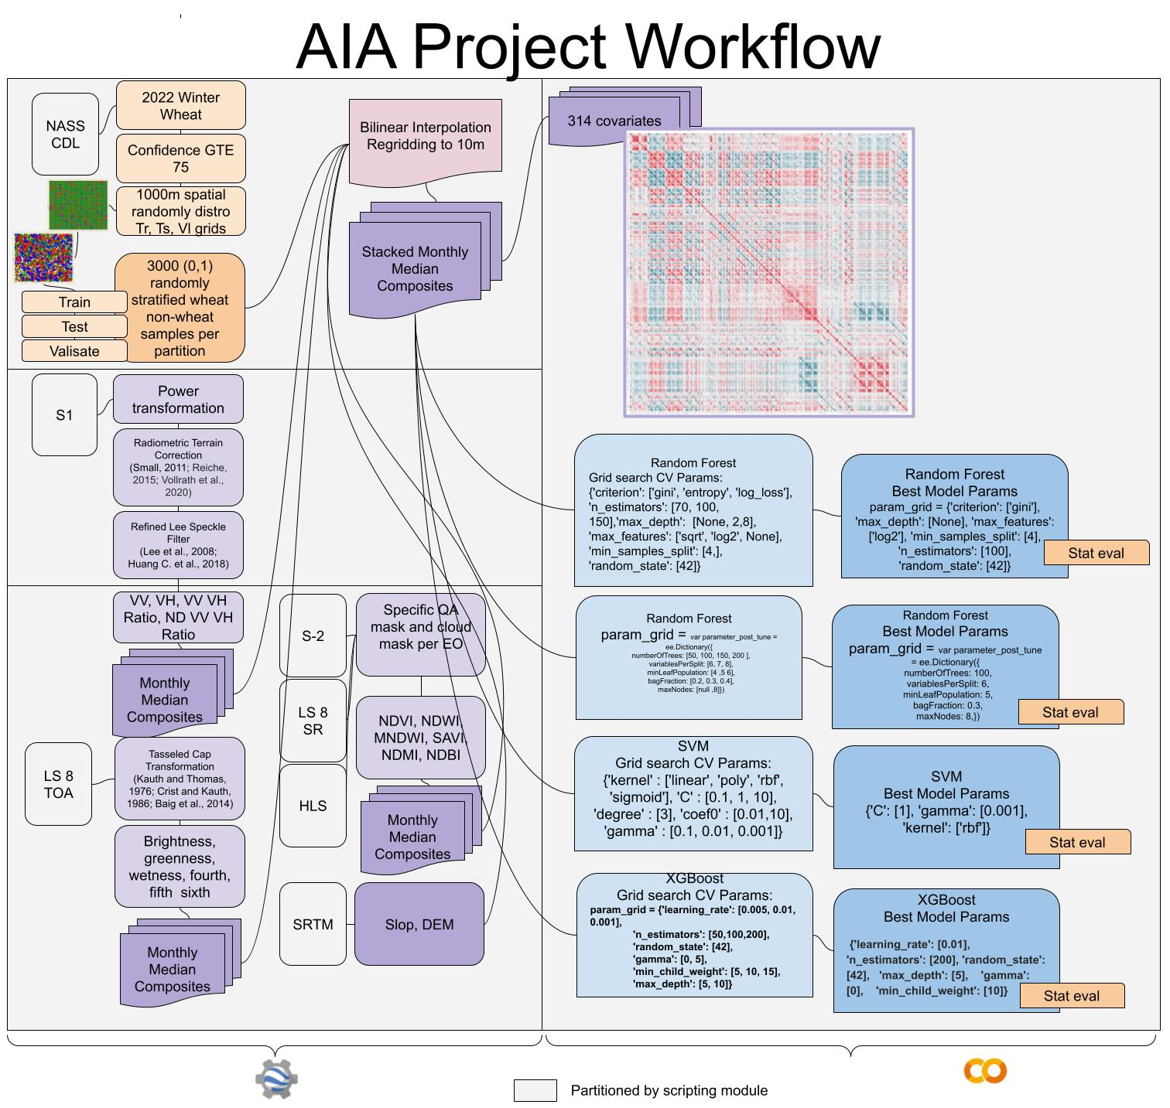
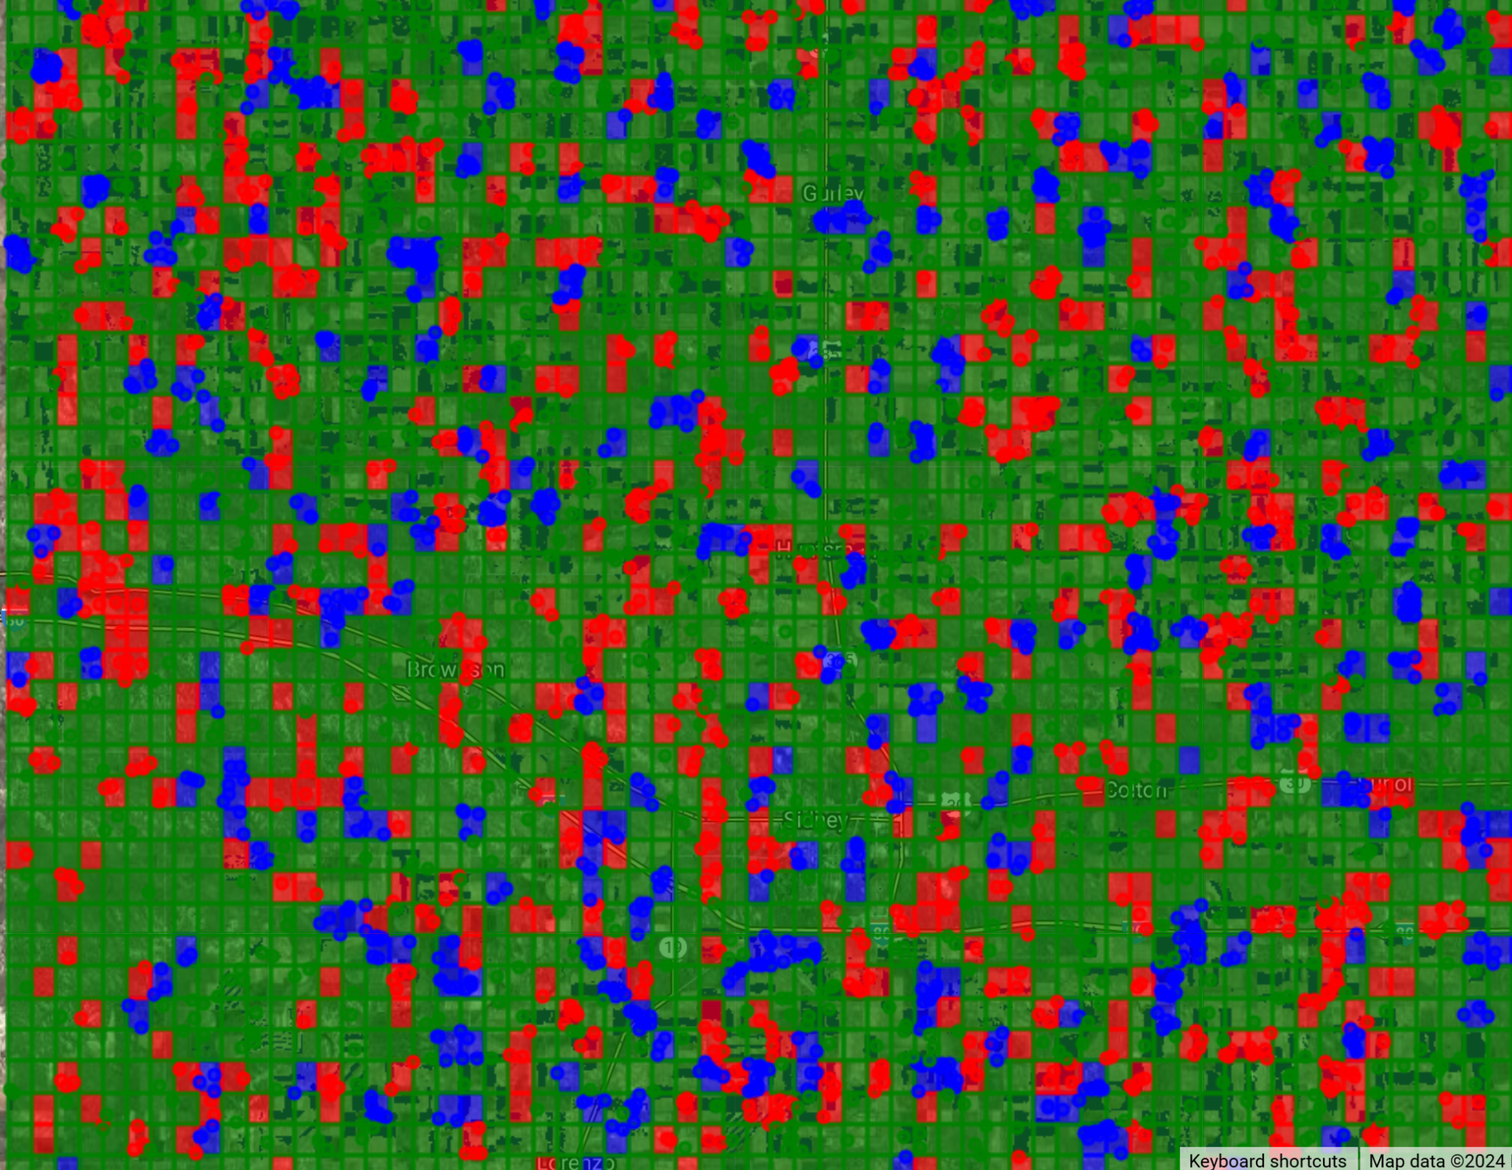
Workflow
Step 1: NASS crop labels
Step 2: S-1 preprocessing
Step 3: Indice generation
Step 4: Stacking and extraction: (height 4008, width 6240, channels 314)
Step 5: Grid Search per algorithm
Step 6: Optimal Params per model
Step 7: Stat eval
Notes:
Oto

Slide 9
Going forward: Individual Monthly Median Composites Stacked
Over the growing season: September 1st-30th , October 1st -31st, …June 1st -30th
Monthly composites
Monthly composites
September 1st-30th
June 1st -30th
Notes:
Tim

Slide 10
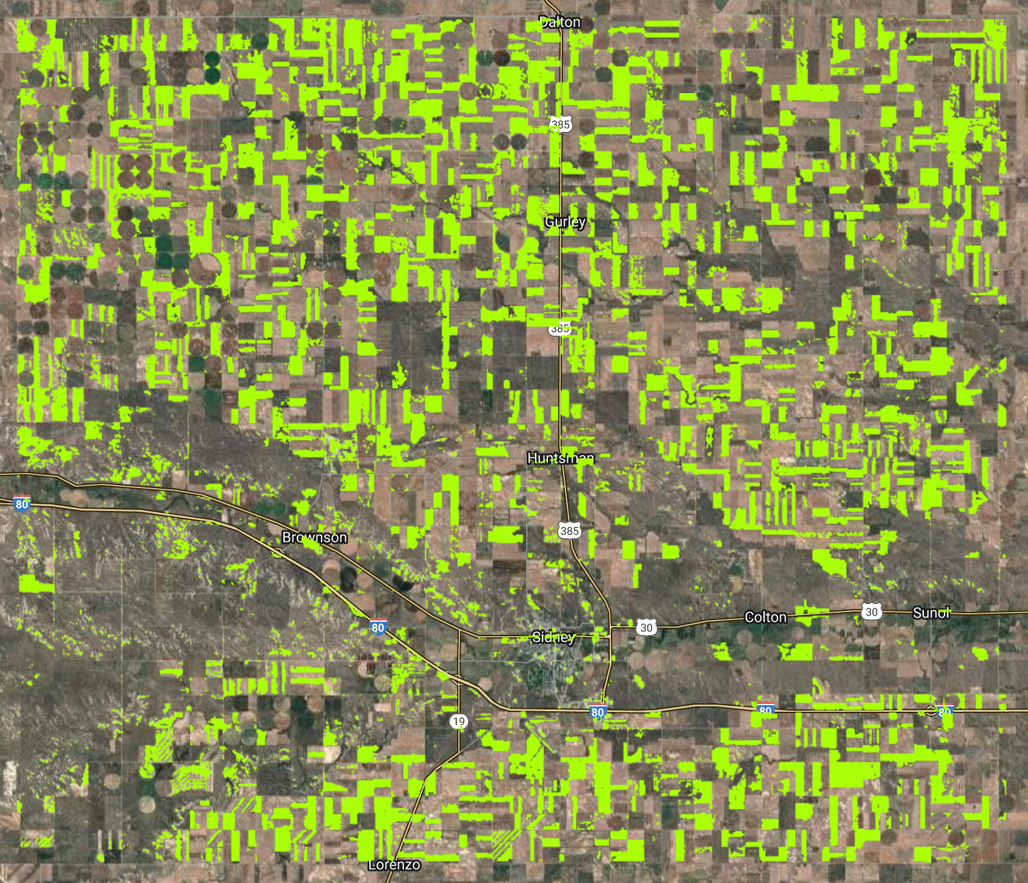
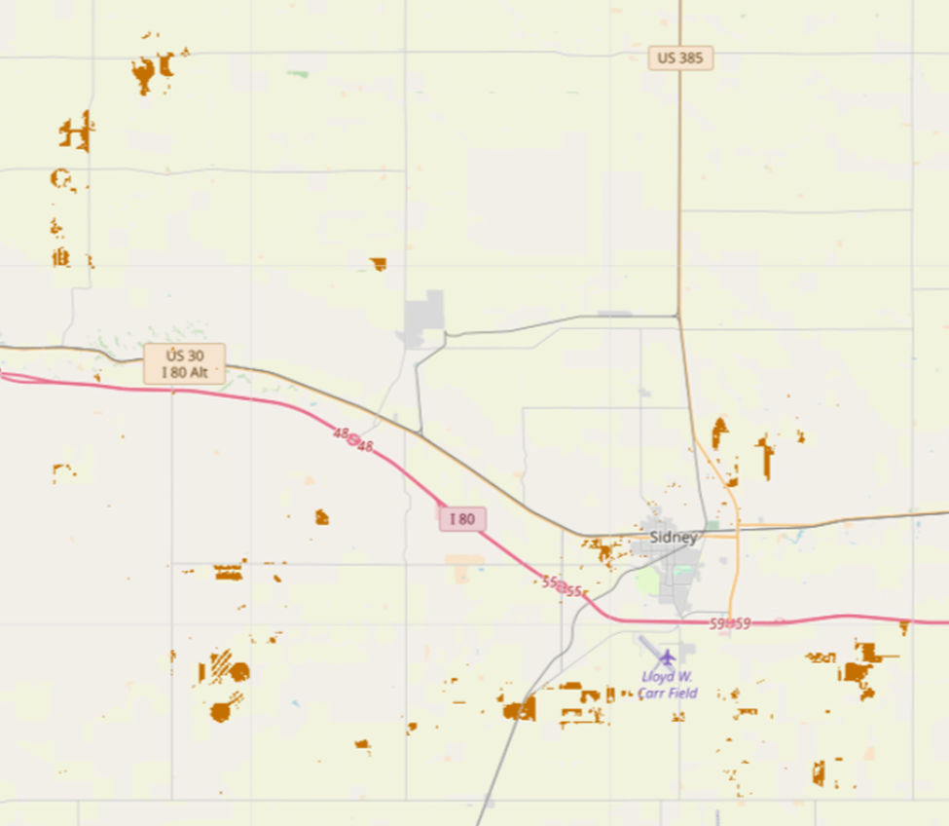
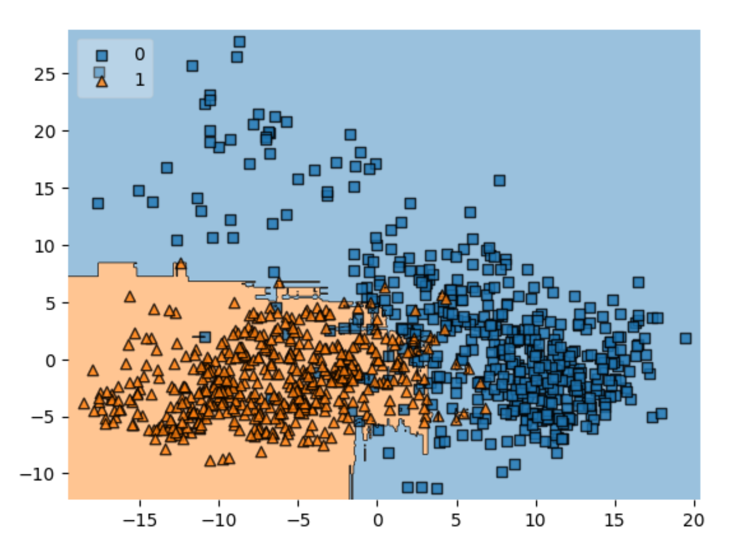
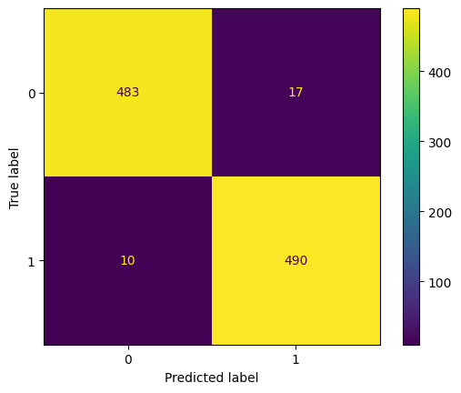
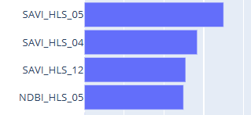
RF - (Scikit learn version)
Feature Importance
Model parameters Tested:
param_grid = {'criterion': ['gini', 'entropy', 'log_loss'],
'n_estimators': [70, 100, 150],
'max_depth': [None, 2,8],
'max_features': ['sqrt', 'log2', None],
'min_samples_split': [4,],
'random_state': [42]}
Final (Best/tuned) Parameters:
param_grid = {'criterion': ['gini'], 'max_depth': [None], 'max_features': ['log2'], 'min_samples_split': [4],
'n_estimators': [100], 'random_state': [42]}
Key Takeaway
April, may, and december of HLS SAVI and May of HLS NDBI has high contribution to the model’s prediction
misclassification occurring along the river," which could mean that the vegetation or land cover characteristics near the river are different from the other areas in the dataset.
Decision region
Winter Wheat
Evaluation metrics | Training | Testing | Validation
Accuracy | 0.951 | 0.951 | 0.973
Precision | 0.959 | 0.959 | 0.966
F1-Score | 0.950 | 0.950 | 0.973
Notes:
Thierry
Oto

Slide 11
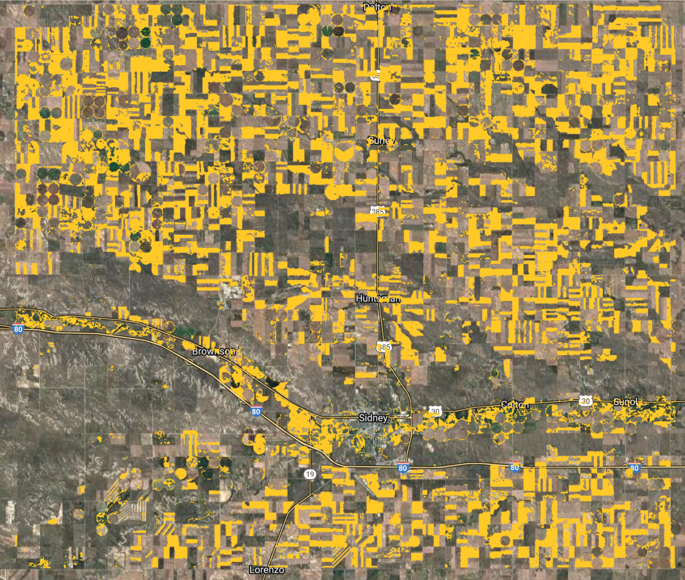
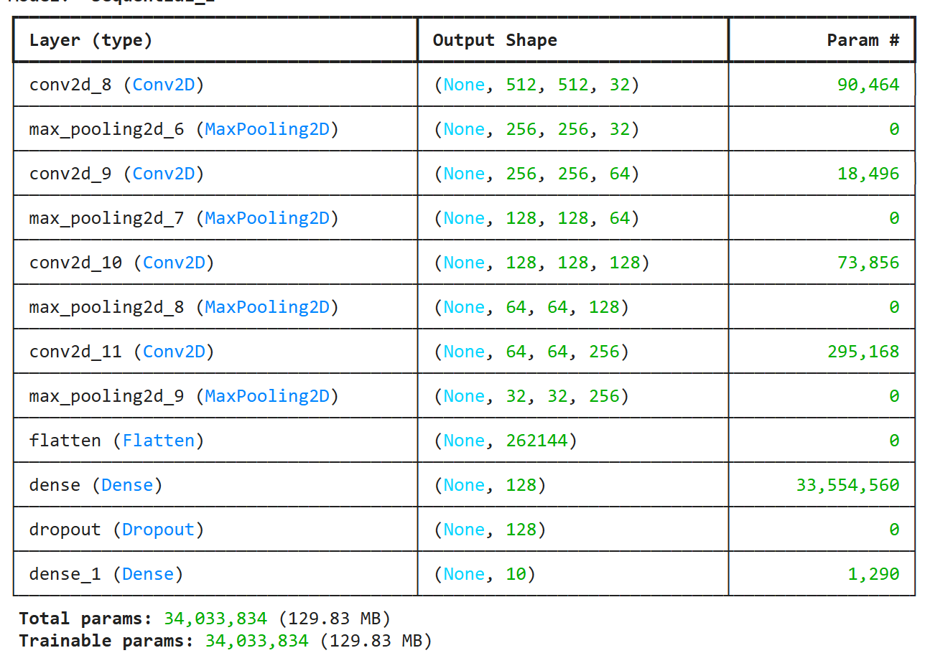
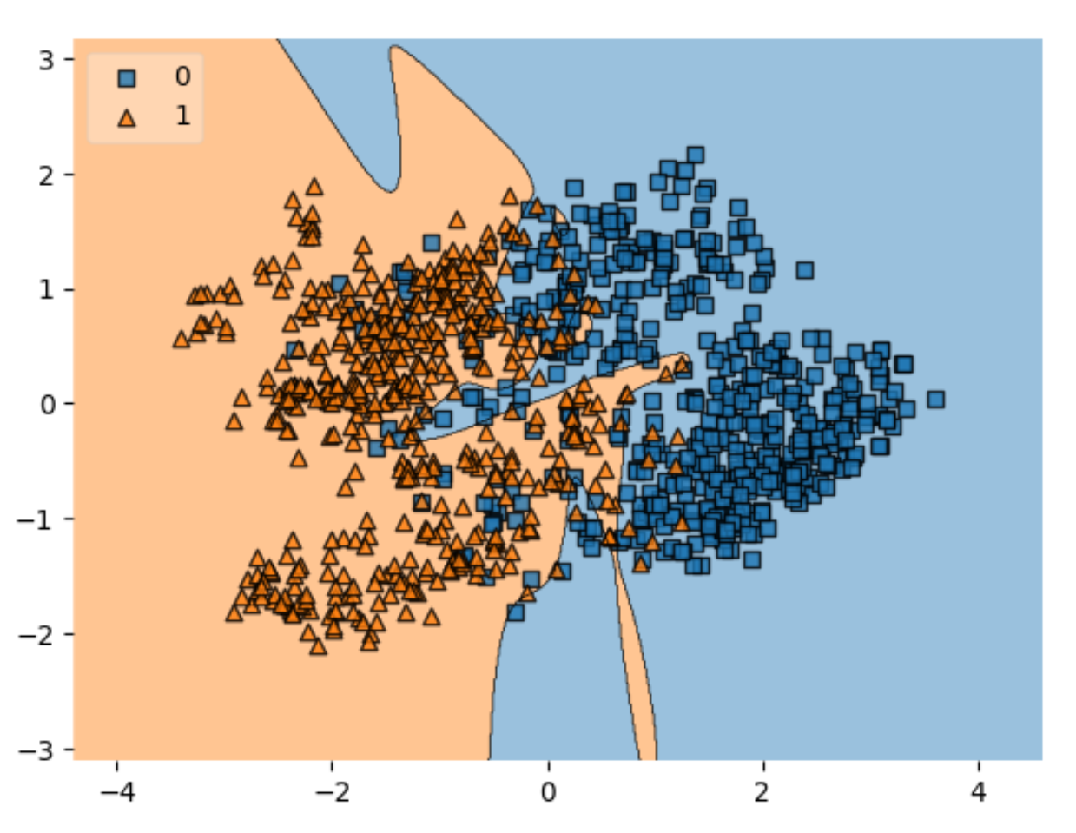
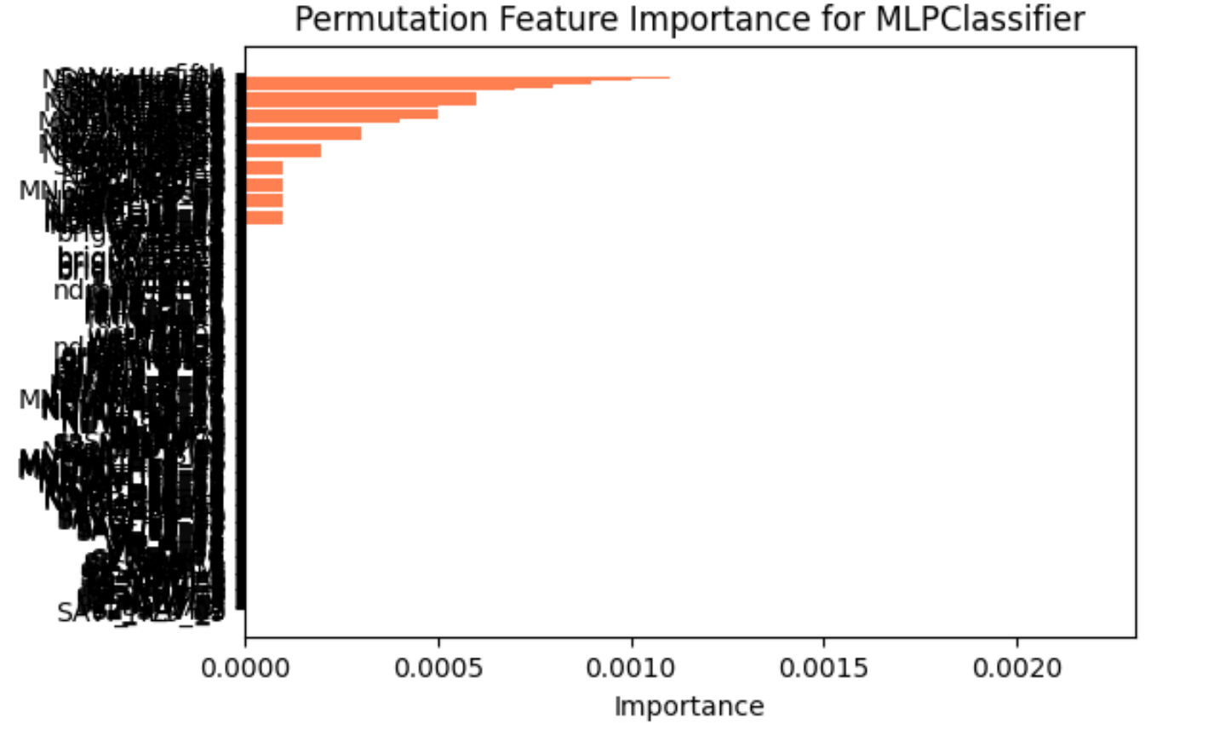
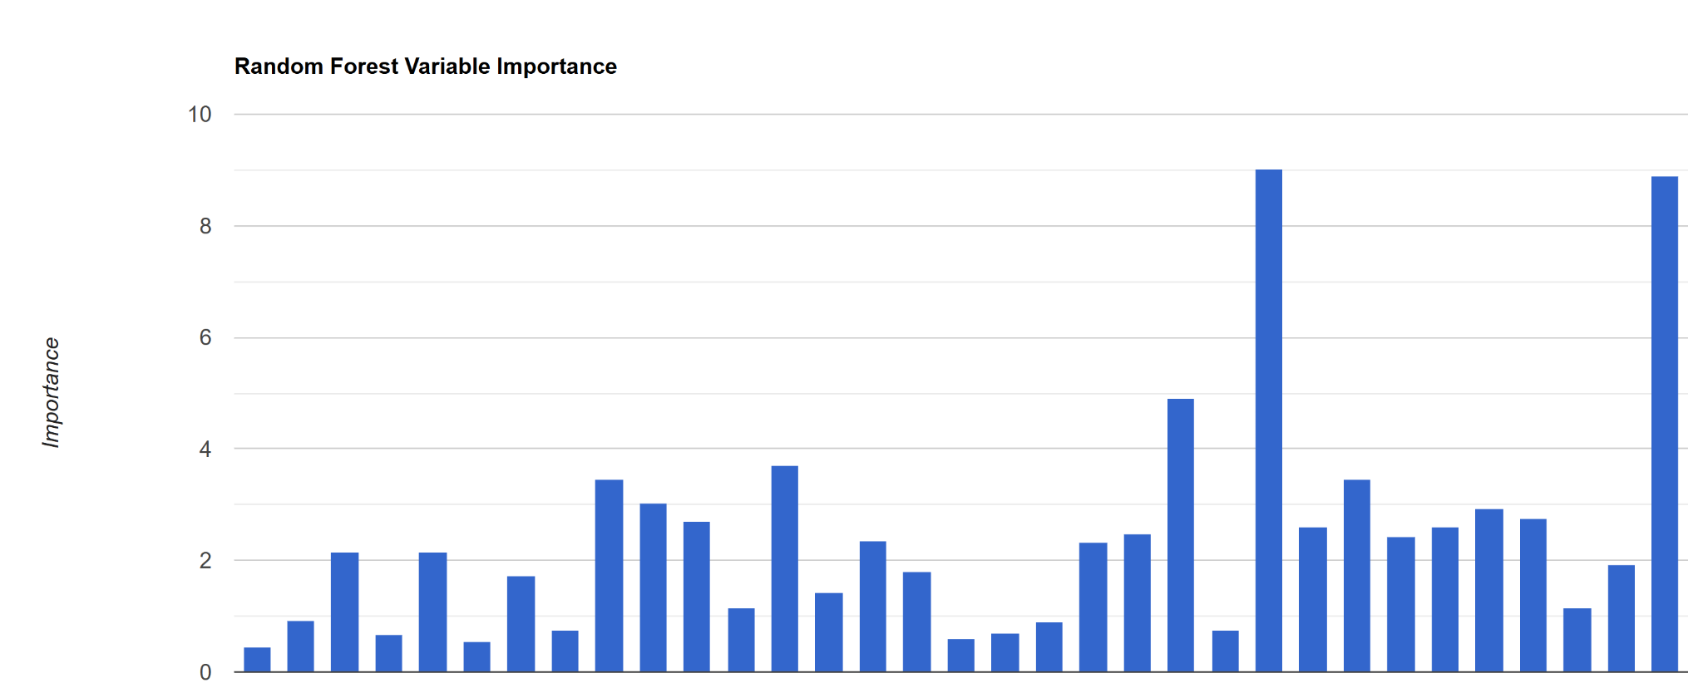
RF - (Smile version)
Model parames tested:
Criterion: Gini
parameter_post_tune = ee.Dictionary({
numberOfTrees: [50, 100, 150, 200],
variablesPerSplit: [6, 7, 8],
minLeafPopulation: [4 ,5 6],
bagFraction: [0.2, 0.3, 0.4],
maxNodes: [null ,8]})
Tuned performing model parameters:
parameter_post_tune = ee.Dictionary({
numberOfTrees: 150,
variablesPerSplit: 6,
minLeafPopulation: 5,
bagFraction: 0.3,
maxNodes: 8,
Key Takeaway
Very limited functionality for gridsearch - very manual process
Limited time to exhaustively search like previous approaches
Unable to plot decision space in platform
April HLS SAVI and NDWI provide feature importance to the model - assumed peak greeness
December NDMI LS and SAVI HLS in (start of dormancy)
Some misclassification occurring along the river
Wheat Prediction
Evaluation metrics | Testing | Validation
Accuracy | 0.947 | 0.939
Precision | 0.940 | 0.939
F1-Score | 0.947 | 0.938
Top:
SAVI_HLS_04
NDWI_HLS_04
NDMI_LS_12
SAVI_HLS_12

Slide 12
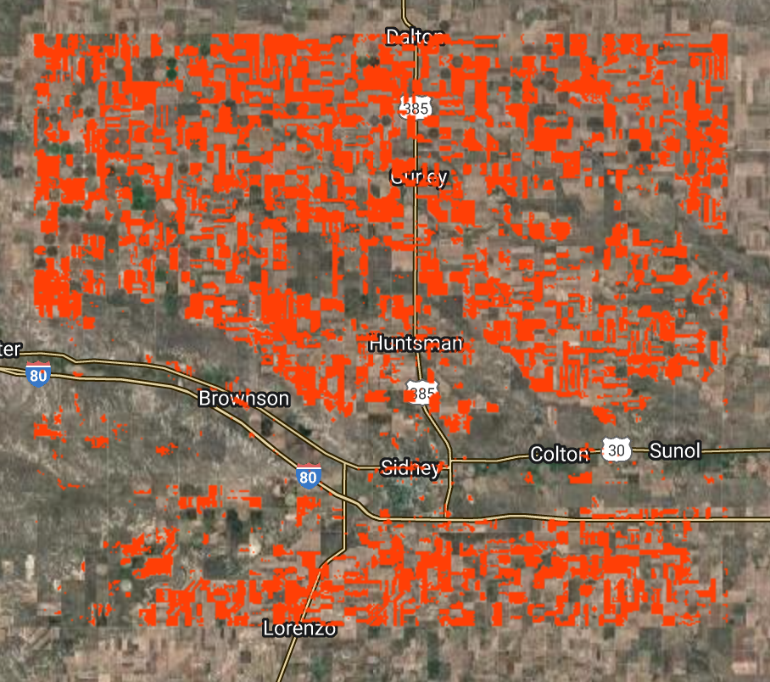
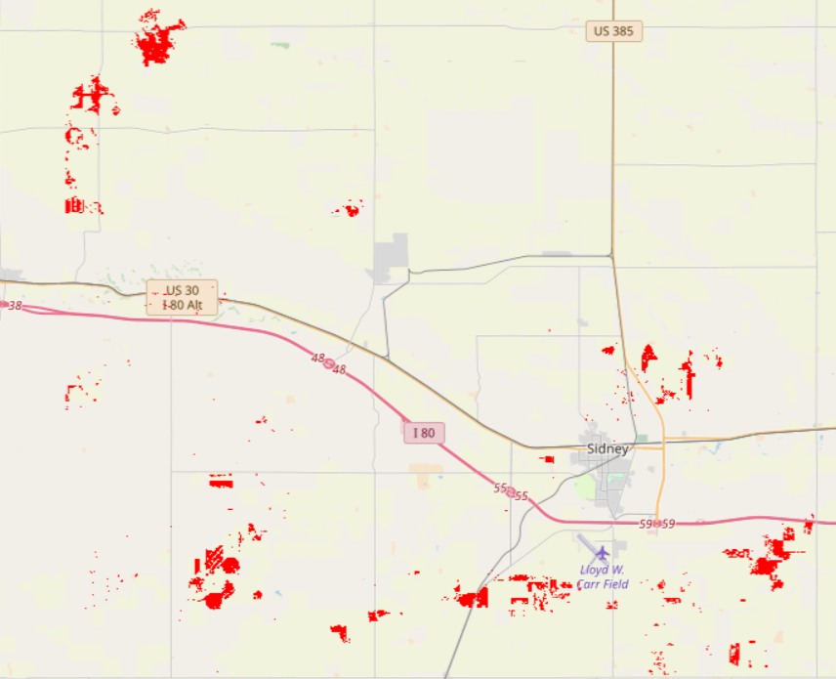
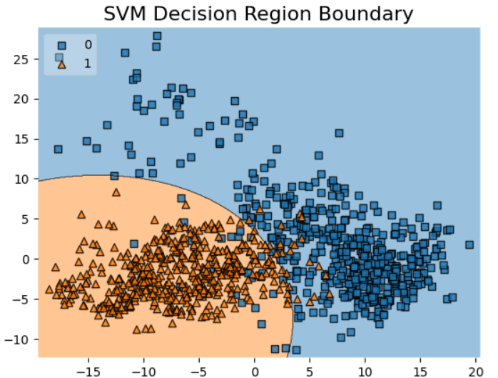
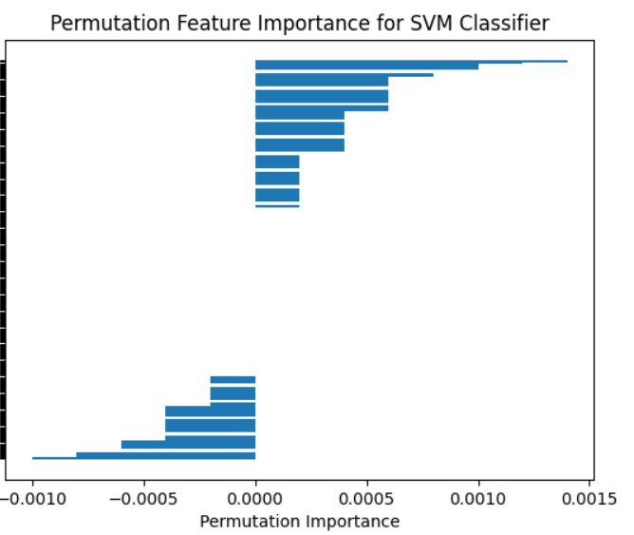


SVM
Model Parameters Tested:
param_grid = {'kernel' : ['linear', 'poly', 'rbf', 'sigmoid'],
'C' : [0.1, 1, 10],
'degree' : [3],
'coef0' : [0.01,10],
'gamma' : [0.1, 0.01, 0.001]}
Final (Best/Tuned) Parameters:
param_grid = {'C': [1], 'gamma': [0.001], 'kernel': ['rbf']}
Key Takeaway
April and May SAVI HLS and EVI Sentinel-2 have higher feature permutation importance, indicating (greenness peak) dense vegetation in heading and grouting stage contributed significantly in model prediction.
Confusion Matrix
Winter Wheat
Evaluation metrics | Training | Testing | Validation
Accuracy | 0.972 | 0.962 | 0.980
Precision | 0.988 | 0.962 | 0.976
F1-Score | 0.972 | 0.962 | 0.980
S2_EVI_4
S2_SAVI_4
SAVI_HLS_5
Notes:
Hamza

Slide 13

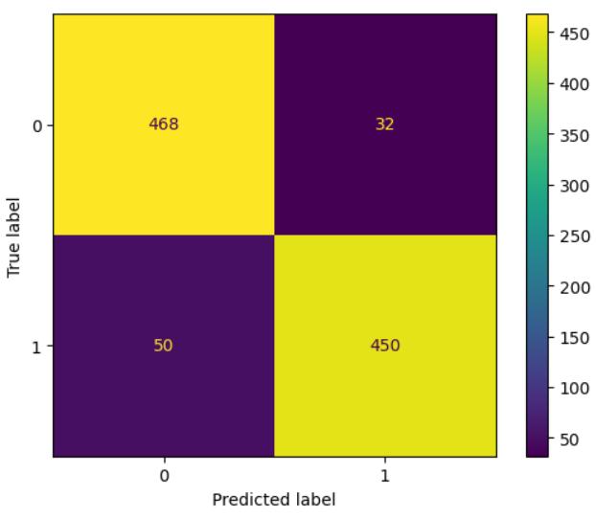
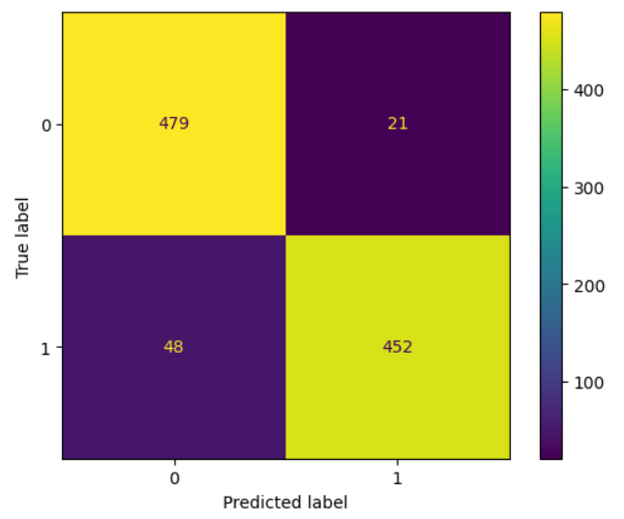
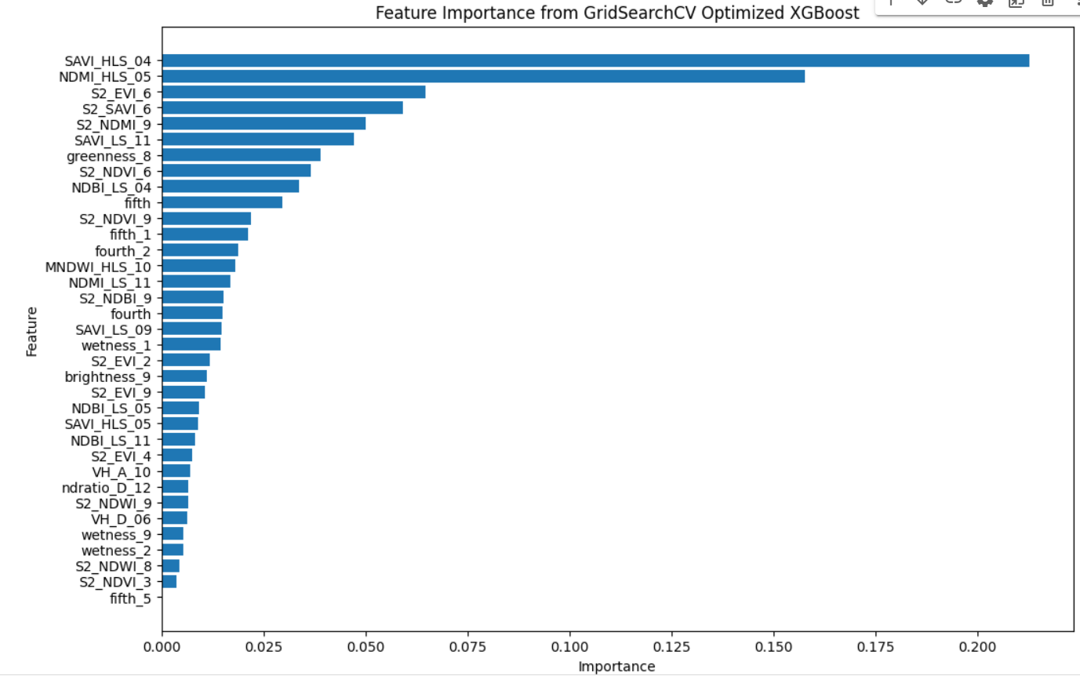
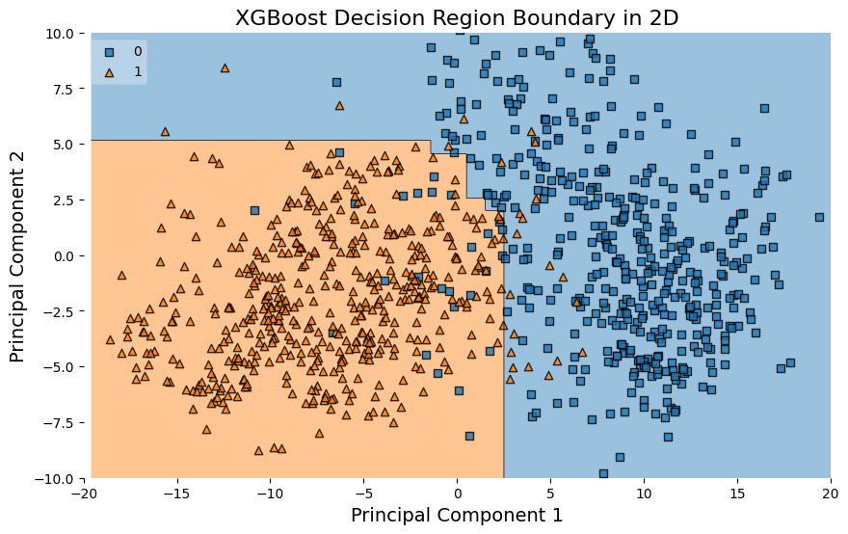
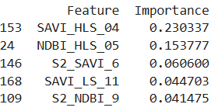
XGBoost
Model Parameters Tested
param_grid = {'learning_rate': [0.005, 0.01, 0.001],
'n_estimators': [50,100,200],
'random_state': [42],
'gamma': [0, 5],
'min_child_weight': [5, 10, 15],
'max_depth': [5, 10]}
Final (Optimal) Parameters:
param_grid = {'learning_rate': [0.01], 'n_estimators': [200], 'random_state': [42], 'max_depth': [5], 'gamma': [0], 'min_child_weight': [10]}
Key Takeaway
-The boundary between classes indicates that the model has learned a non-linear separation, which is typical for XGBoost
-Features like SAVI_HLS_04, NDMI_HLS_05, S2_EVI_6, S2_SAVI_6, and S2_NDMI_9 have the highest importance, indicating they were critical in determining the model's predictions.
Evaluation metrics | Training | Testing | Validation
Accuracy | 0.93 | 0.931 | 0.931
Precision | 0.96 | 0.931 | 0.955
F1-Score | 0.93 | 0.929 | 0.929
Notes:
Oto

Slide 14
Takeaways/Caveats/Next Steps
Takeaways:
The study was geographically limited due to time and processing effort. So conclusions regained best performing model should be constrained to this limited scope
All models provided high train, test, and validation metrics (0.973, 0.939, 0.980, and 0.931 for RF-sci kit, RF-smile, SVM, and XGB validation accuracy respectively) suggesting sufficient application post tuning effort. SVM providing the highest relative accuracy validation metrics
Including monthly may have been valuable (still to be determined with a head to head comp). But peak greeness around April (SAVI HLS 4 for instance) appears to be important across models
Future work could focus on using just this feature
Caveats:
We believe the labels from the NASS crop layer are useful, but we’re not fully certain of their accuracy on the ground. This study is more of a demonstration of our methods rather than a definitive result on crop stages
To the previous caveat no in situ field data was used for the validation, rather we are comparing to the existing NASS layer. So future work could look to partition a field observation sample for validation
Notes:
Tim

Slide 15
Takeaways/Caveats/Next Steps
Future Work:
Due to limited time, (and especially compute) additional steps such as step forward and step backward variable selection was omitted, but we would recommend this strategy for SVM for future work.
As well as for removing highly correlated variables for tree based algorithms to reduce the covariate number to be more parsimonious
Many RS features, however for future work suggest keeping the scale small (especially regarding compute)
Especially focusing on redundant spectral RS features such as HLS/LS/S2
Head to head study employing Cochran Q and McNemar as the these model satisfy the statistically assumptions and will enable an approach to statistically determine the relative performance (limited due to time, but plan future work)
Explore testing different NASS cropland confidence threshold for weak label generation. We kept this static for this test but this is a potential future work
As there are 3 wheat classes and 6 other “mixed/split” classes within the NASS layer exploring the ability to distinguish specific crop types and mixed types would be a valuable
Expand the 9 month v. monthly composite algorm. comparison as this could help with reducing the processing and training effort.
Ability to spatially predict Xgboost (Just limited time)
As the preprocessing steps enables our team to derive a phenological trends, extending this work over multiple years would help refine our model and improve its accuracy.
Apply the SVM model (best model) to next years imagery and assessing the performance in future years
Explore a Meta model approach or DL in the future just limited time
Additionally, exploring an inherently temporally oriented algorithm such as an LSTM which is designed to model sequential phenomena would be of value. Our time was limited by time to explore this concept.
Biggest takeaway compute was limited for exploring other methods -scale accordingly
Notes:
Tim

Slide 16

Final Products
Binary crop type map extent of wheat for 2022
Set of tuned and trained models
Intercomparison of modeling techniques
Code library
QR to Code library
Notes:
Tim

Slide 17
Questions
Thank You!
Notes:
Tim
https://nebraskawheat.gov/for-growers/wheat-production-handbook/wheat-growth-stages/
Wang, S., Rao, Y., Chen, J., Liu, L. and Wang, W., 2021. Adopting “difference-in-differences” method to monitor crop response to agrometeorological hazards with satellite data: a case study of dry-hot wind. Remote Sensing, 13(3), p.482.
Heuer, G.R., Heermann, D.F., McKee, T.B. and Benci, J.F., 1978. Predicting winter wheat phenology using temperature and photoperiod (Master's thesis, Colorado State University).

Slide 18
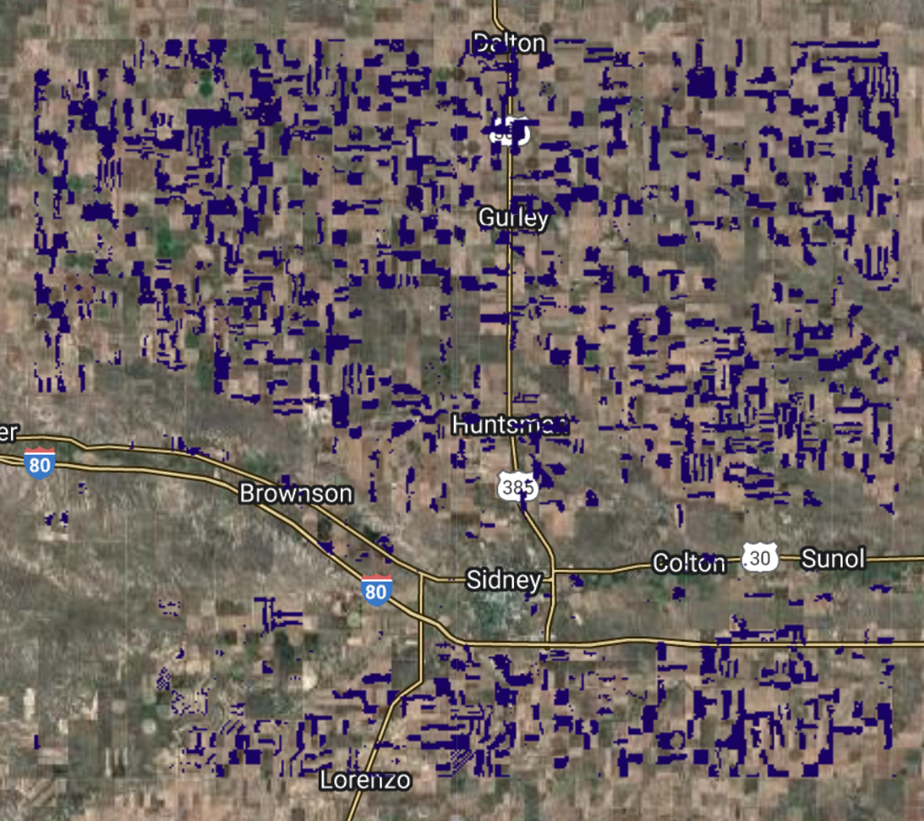
2022 Labels
Spatially partitioned 1000m
Train 70
Test 20
Validation 10
Randomly distributed per strata (Tr, Ts, Vl)
1000 points per split
500 non crop
500 crop
NASS crop labels
Sample design

Slide 19
Comp. maps
NASS Winter Wheat
RF SK learn
SVM
RF Smile

